Slide 1
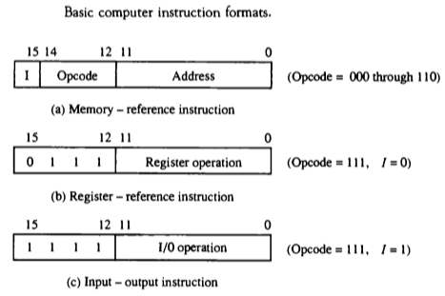
Computer Instructions
The basic computer has three instruction code formats.
Each format has 16 bits.
The operation code(op-code) part of the instruction contains three bits and the meaning of remaining 13 bits depends upon the op-code encountered.

Slide 2
Instruction Cycle
A program residing in the memory unit of the computer consists of a sequence of instructions.
The program is executed in the computer by going thru a cycle for each instruction.
In basic computer, each instruction cycle consists of the following phases:
Fetch an instruction from memory.
Decode the instruction.
Read the effective address from memory.
Execute the instruction.

Slide 3
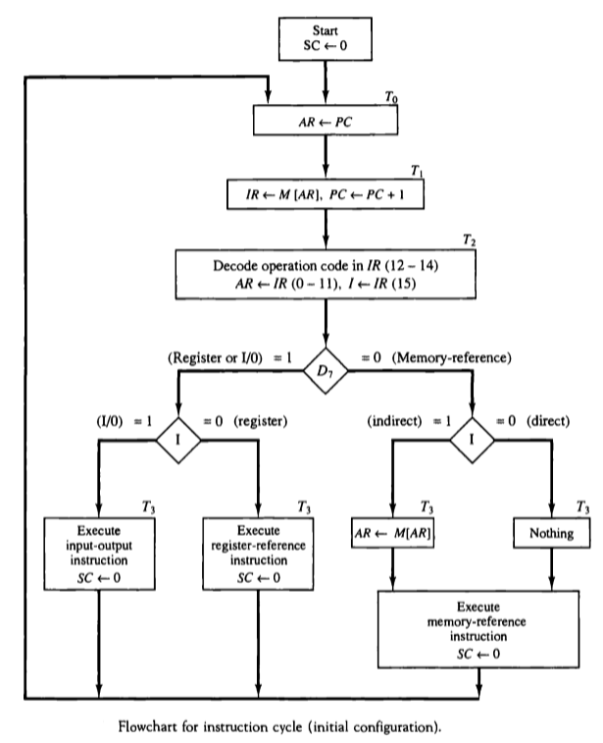
Instruction Cycle

